Slide 1
Chapter 2: Food and digestion
Miss Luzma Fabre

Slide 2
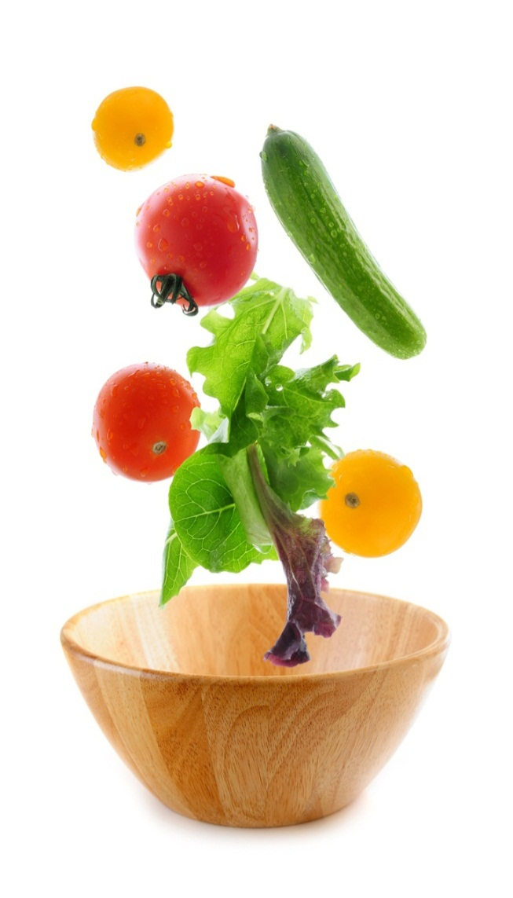
Section 1: Food and energy
Foods provide your body with materials for growing and for repairing tissues. Food also provides energy for everything you do.
It helps maintain homeostasis (keeps the body´s internal environment stable)

Slide 3
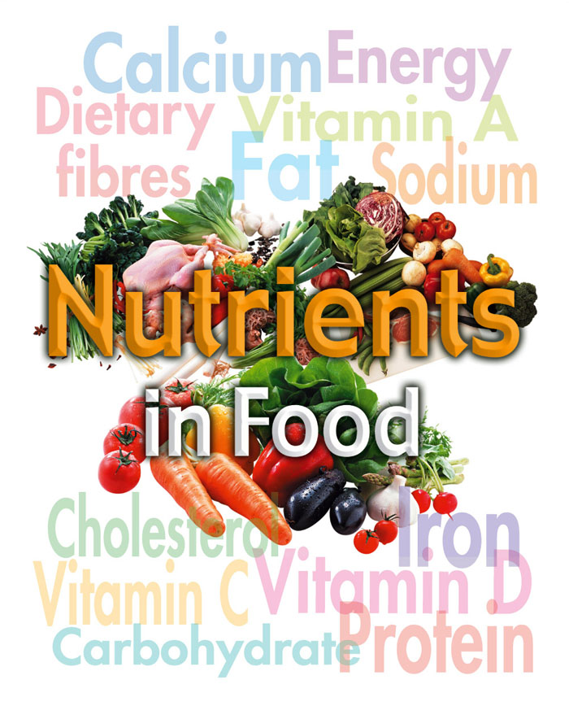
Nutrients
Nutrients are the substances in food that provide the raw materials and energy the body needs to carry out all its essential processes.
6 groups of nutrients:
Carbohydrates
Fats
Proteins
Vitamins
Minerals
water

Slide 4
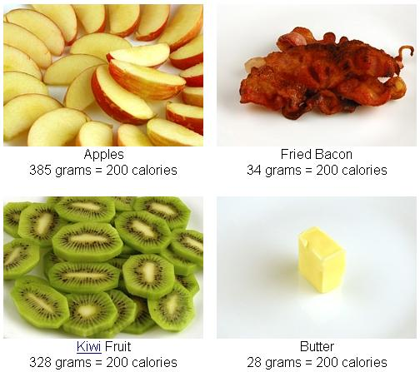
Energy
The amount ofenergy released by the nutrients can be measured in units called calories.
One calorie is the amount of energy needed to raise the temperature of 1 gram of water by 1°C

Slide 5
One Calorie (capitalized) is the same as 1 kilocalorie (kcal)
More calories = more energy
Ex: a small apple: 60 kcal , Snickers: 250 kcal , slice of carrot cake: 326 kcal

Slide 6
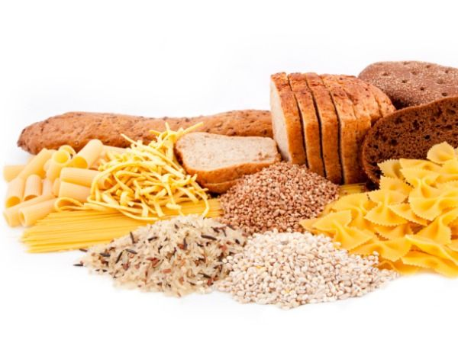
Carbohydrates
Composed of carbon, hydrogen, oxygen
1 gr= 4 kcal
Carbohydrates also provide raw materials to make cell parts.
Simple
Complex
Carbohydrates

Slide 7
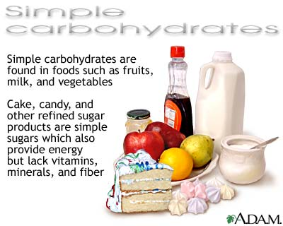
Simple carbohydrates
Known as sugars
Ex: glucose
Glucose is the major source of energy for your body´s cells

Slide 8
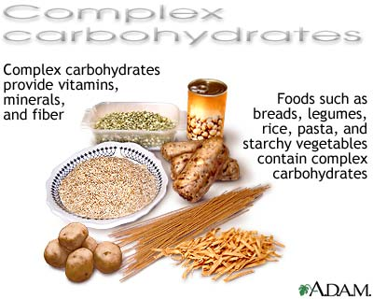
Complex carbohydrates
Made up of many sugar molecules linked
Fiber and starch
Ex: starch (potatoes, rice, wheat, corn) is broken down into sugar molecules
Fiber cannot be broken down into sugar molecules, it passes through the body and is eliminated

Slide 9
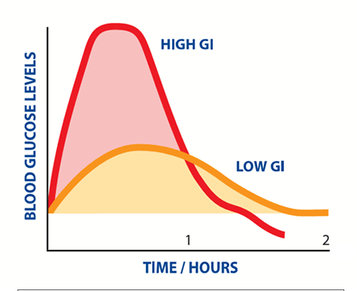
Nutritionists´ Recommendations
45-65% of the calories should come from carbohydrates
Prefer complex carbohydrates such as whole grains
Avoid simple carbohydrates

Slide 10
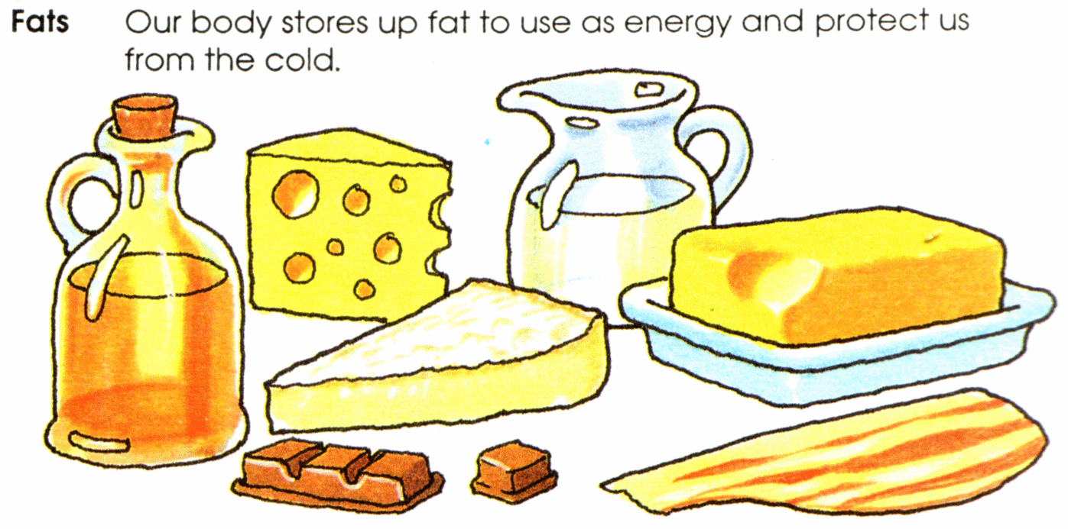
Fats
Composed of carbon, oxygen, and hydrogen
1 gram= 9 kcal
Functions of fats:
Provide energy
Form part of the cell membrane
Fatty tissue protects and supports your internal organs and insulates your body

Slide 11
Saturated: solid at room temperature
Ex: meat
Unsaturated: liquid at room temperature
Ex: cooking oils
Trans fat: are made by adding hydrogen to vegetable oils
Ex: margarine, chips.
Kinds of fats

Slide 12
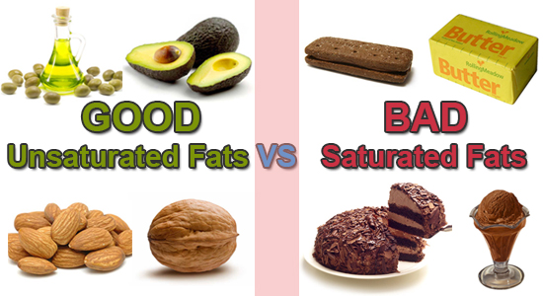

Slide 13
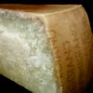
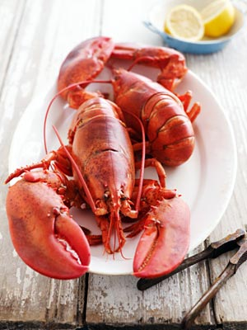
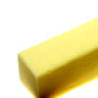
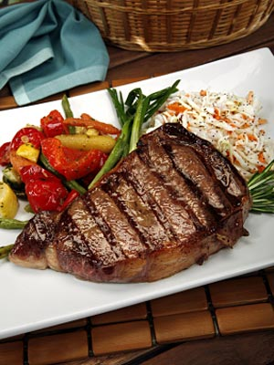
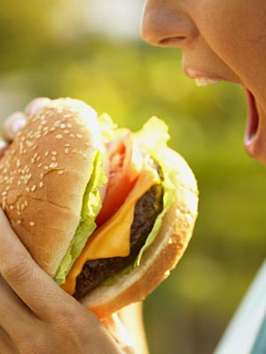
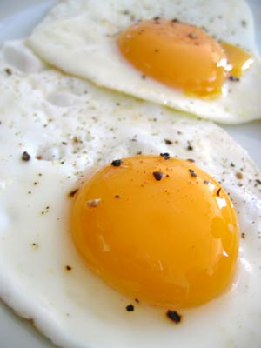
Cholesterol
Waxy, fatlike substance found in animal products
Part of body´s cells

Slide 14
Nutritionists´ Recommendations
No more than 30% of your daily calories should come from fats

Slide 15
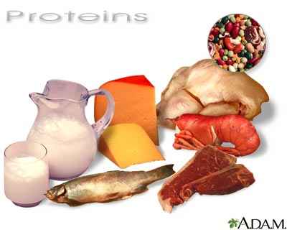
Proteins
Contain nitrogen, carbon, hydrogen, oxygen
Needed for tissue growth and repair
Important role in chemical reactions in cells
1 gr= 4 kcal
10-35% of your daily calorie intake

Slide 16
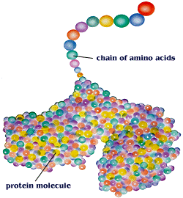
Proteins are made up of aminoacids that are linked together.

Slide 17
Complete and incomplete proteins
Foods from animal sources, such as meat and eggs, are called complete proteins because they contain all the essential aminoacids (aminoacids that are not produced by our body)
Proteins from plant sources, such as beans, grains, and nuts, are called incomplete proteins because they are missing one or more essential aminoacid

Slide 18
Vitamins and minerals
Vitamins act as helper molecules in a variety of chemical reactions in the body
Fat-soluble: vitamin A, D, E, K
Water-soluble: vitamins B and C
Vitamins

Slide 19
Minerals
Nutrients that are not made by living things
Both vitamins and minerals are needed by your body in small amounts to carry out chemical processes

Slide 20
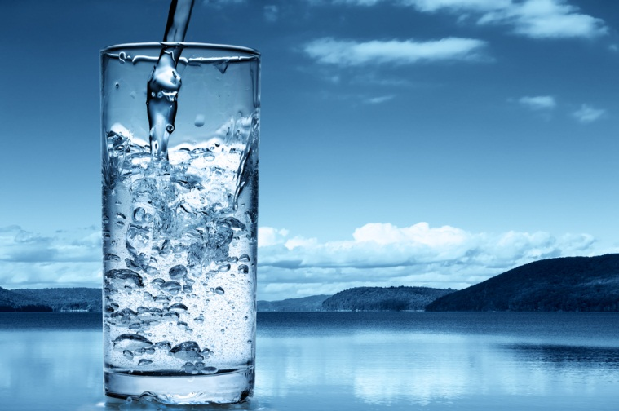
Water
Water is the most important nutrient because the body´s vital processes, including chemical reactions such as the breakdown of nutrients, take place in water

