Slide 1
The Periodic Table

Slide 2
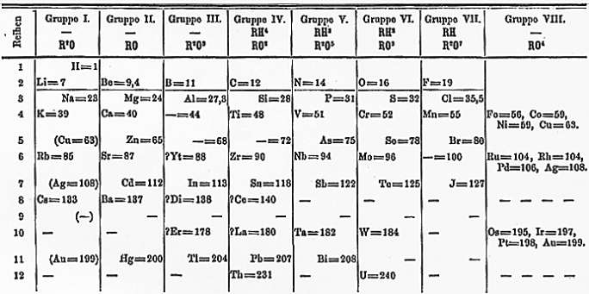
Mendeleev
By 1869, there were 63 known elements
Mendeleev organized elements by atomic mass and chemical reactivity
Created the first widely accepted periodic table

Slide 3
Mendeleev Continued
Mendeleev found patterns by arranging cards with names, masses, and other physical and chemical properties of elements
Placed elements into numbered groups based on similarities in “combining powers” or ability to react
Ex) Alkali metals had “combining power” of one and went in group I
Ex) Alkaline earth metals had “combining power” of two and went in group II

Slide 4
Mendeleev Cont.
Properties of some elements did not fit when arranged by atomic mass
Properties of some elements indicated that more massive elements should come before less massive ones
Discovery of isotopes later explained inaccurate masses
Mendeleev relied more on similarities in proprieties than order of masses to arrange elements
Left blank spaces for elements that had not been discovered
Predicted chemical reactivity and masses for gallium, scandium, and germanium

Slide 5
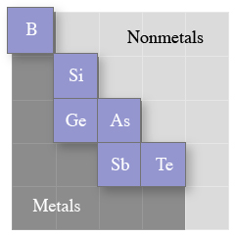
Periodic Table
Periodic table is in order of increasing atomic number and organizes elements according to chemical properties
Behavior of elements can be predicted by placement on periodic table
Periodic table is divided by a step-wise line
Metals are to the left
Nonmetals are to the right

Slide 6
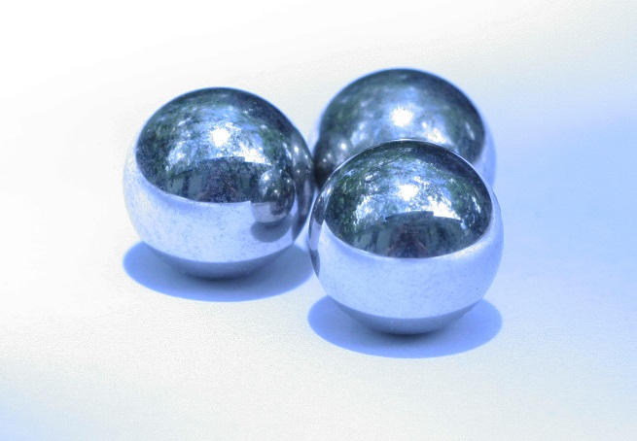
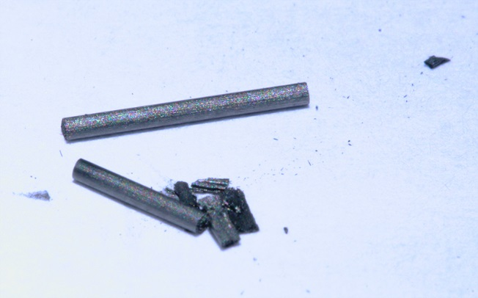
Metals and Nonmetals
Metals
Found on left side of periodic table
Lose electrons to form cations
Lustrous
Good conductors
Malleable and ductile
Nonmetals
Found on right side of the periodic table
Gain electrons to form anions
Often gases or brittle solids at room temperature
Poor conductors

Slide 7
Metalloids
Metalloids – the set of elements that separate the metals from the nonmetals on the periodic table and that possess properties of both metals and nonmetals
Properties more moderate than metals or nonmetals
Solids at room temperature
Less brittle than nonmetals
Less malleable than metals
Many are semiconductors
Ex) Silicon often used in
electronic devices to moderate
flow of electricity

Slide 8
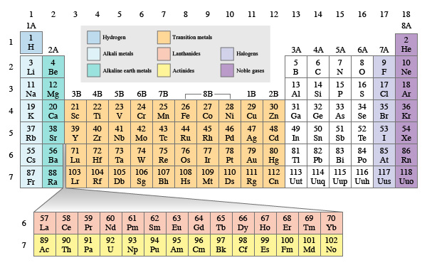
Groups and Periods
Period – a row on the periodic table
Groups – a column on the periodic table, also known as a chemical family since elements in groups share similar chemical properties
Notes:
While the general area in which an element is located on the periodic table indicates whether it is a metal, nonmetal, or metalloid, its location in a specific group and period gives even more information about the properties of an element. The periodic table is arranged in seven periods or rows, and 18 groups or columns. Groups are also called families, since elements in groups share similar properties.

Slide 9
Groups and Periods
Main-group elements – the elements found in an A group on the periodic table
Show periodic patterns most clearly
Notes:
Groups can be numbered either one through eighteen or one through eight with an “A” notation given to the tall columns and “B” notation to the short columns.
Group A elements are known as the main-group elements.
Main-group elements tend to show periodic patterns most clearly and consistently.

Slide 10
Groups and Periods
Family names can be used to identify groups
Notes:
Family names may also be used to identify groups. The periodic table in the figure shows the location and name of each chemical family on the periodic table. Group 1A elements are the alkali metals; group 2A elements are the alkaline earth metals; group 7A elements are the halogens and group 8A elements are the noble gases. The short groups in the middle of the table, groups 1–8B, are collectively called the transition metals.

Slide 11
Groups and periods
Group number of group A elements indicates the number of valence electrons
Elements in an A group share most stable oxidation state
Notes:
The group number of group A elements indicates the number of valence electrons, which are the electrons in the valence or outermost energy level. They are the electrons that are most likely to be lost, gained, or shared. Ions are formed when electrons are lost or gained.
Therefore, elements in the same group A group tend to share their most stable oxidation state, or charge as an ion.
The oxidation state is positive if electrons are lost to form the ion.
The positive charge is equal to the number of electrons lost.
The oxidation state is negative if electrons are gained to form the ion.
The magnitude of the charge is equal to the number of electrons gained.

Slide 12
Noble Gases
Noble gases – the elements in group 8A on the periodic table
Nonreactive
Gases at room temperature
Each emits different color light when excited electrons return to
ground state
Notes:
Group 8A, the noble gases, are relatively inert or nonreactive because they already have full valence shells. Therefore, noble gases don’t typically lose or gain electrons to form ions. Other groups attempt to achieve full valence shells by gaining, losing, or sharing electrons. This means that all other groups have higher reactivity than the noble gases.
As indicated by their name, noble gases are gases at room temperature. The noble gases include helium, neon, argon, krypton, xenon, and radon.
Noble gases such as neon are commonly used in so-called “neon signs.” When atoms of noble gases return to the ground state from an electronically excited state, they emit light. Each element emits a different color of light.

Slide 13
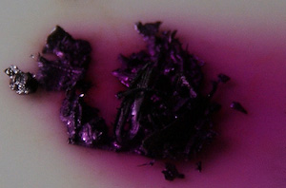
Halogens
Halogens – the elements in group 7A on the periodic table
Highly reactive nonmetals
Seven valence electrons
Gain one electron to complete octet
Have –1 charge as ions
Notes:
Group 7A, the halogens, are highly reactive nonmetals containing seven valence electrons.
In other words, they are one electron short of an octet. They gain an electron to complete their octet and have a –1 charge as ions as a result.
Because they are very close to achieving an octet, they are very electronegative or possess the ability to attract electrons readily.
Halogens form ionic bonds by accepting electrons from metals, and they form covalent bonds by sharing electrons with other nonmetals.
When hydrogen halides are dissolved in water they create acidic solutions. The halogens include fluorine, chlorine, bromine, iodine, and astatine.

Slide 14
Alkali Metals
Alkali metals – the elements in group 1A on the periodic table
Highly reactive metals
One valence electron
Lose one electron to attain octet
Form ions with +1 charge
Notes:
Group 1A, the alkali metals, are highly reactive metals with one valence electron.
They are one electron away from having an octet. They readily lose one electron in order to attain an octet and form ions with +1 charge as a result.
Alkali metals form oxides by combining with oxygen and create salts by forming ionic bonds with nonmetals. (A salt is an ionic compound that can be formed as a result of an acid-base reaction.)
Alkali metal hydroxides form strong bases when dissolved in water.
When pure alkali metals are allowed to react with water, violent reactions occur. These reactions produce hydrogen gas and a strong base and release energy in the form of light, heat, sound, and motion.
The further down in group 1A an alkali metal is on the periodic table, the more energy is released by its reaction with water. The alkali metals include lithium, sodium, potassium, rubidium, cesium, and francium.

Slide 15
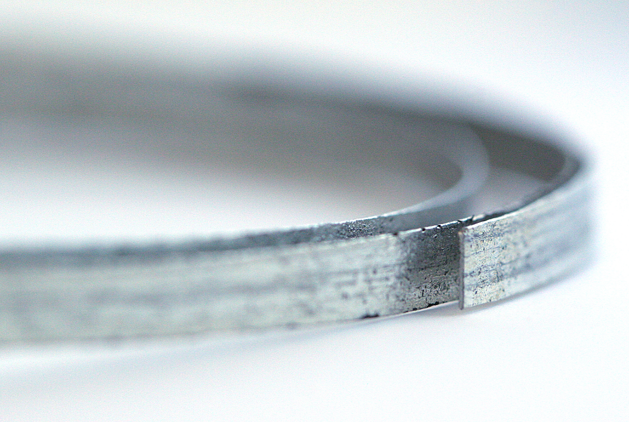
Alkaline Earth Metals
Alkaline earth metals – the elements in group 2A on the periodic table
Highly reactive metals
Two valence electrons
Lose two electrons to attain octet
Ions have +2 charge
Notes:
Group 2A, the alkaline earth metals, are also highly reactive.
They contain two valence electrons and are two electrons away from having an octet.
They lose their two valence electrons to attain an octet, giving their ions a +2 charge.
Like the alkali metals, alkaline earth metals form oxides by combining with oxygen.
They can also form ionic bonds with nonmetals to create salts.
Alkaline earth metal hydroxides form bases when dissolved in water. The alkaline earth metals include beryllium, magnesium, calcium, strontium, barium, and radium.

Slide 16
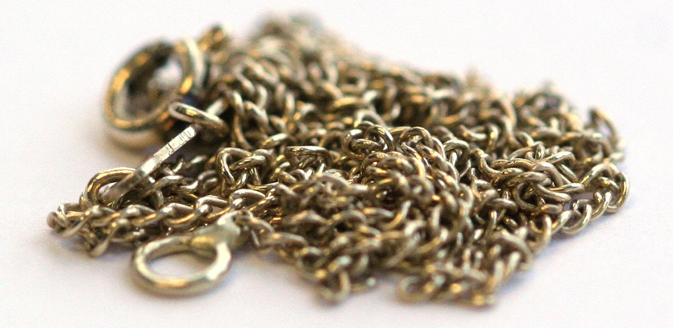
Transition Metals
Transition metals – the elements in groups 1B–8B on the periodic table
Display variety of oxidation states, even within a group
Most display multiple oxidation states
Form more than one unique compound with a given nonmetal
Ex) Iron combines with oxygen to form FeO or Fe₂O₃
Less reactive than alkali or alkaline earth metals
Ex) Iron, gold, copper, nickel, silver
Notes:
The 10 short columns in the middle of the periodic table, groups 1B–8B, are collectively called the transition metals.
The transition metals display a variety of oxidation states. Even transition metals that are in the same group may display different oxidation states.
Most elements that are transition metals display multiple oxidation states (or can form ions with a variety of charges).
As a result, most transition metals can form more than one unique compound with a given nonmetal.
For example, iron can have an oxidation number of either +2 or +3. Therefore, iron can form either iron(II) oxide, which has the formula FeO, or iron(III) oxide, which has the formula Fe₂O₃, when combined with oxygen.
While they are still reactive, transition metals are less reactive than alkali metals or alkaline earth metals.
Examples of transition metals include familiar metals such as iron, gold, copper, nickel, and silver.

Slide 17
Lanthanides and Actinides
Subsection of transition metals with unique chemical and physical properties and silvery, lustrous appearance
Lanthanides – the elements in period 6 elements with atomic numbers from 57–70
All found in nature
Actinides – the elements in period 7 elements with atomic numbers from 89–102
Radioactive
Notes:
The lanthanides and actinides (sometimes referred to as the rare earth metals) are a subsection of the transition metals. These two series are typically shown separated from the other transition metals because of their unique chemical and physical properties. (Dividing these series out also makes the periodic table easier to display in a limited amount of space.) Although these series are usually shown detached, the atomic numbers of the lanthanide and actinide series fit between groups 2A and 3B in periods 6 and 7 of the periodic table.
The lanthanides are composed of period 6 elements with atomic numbers from 57–70 and the actinides are composed of period 7 elements with atomic numbers from 89–102. Like other transition metals, these two series contain elements that display a variety of oxidation states. Lanthanide and actinide metals have a silvery, lustrous appearance.
Unlike actinides, all lanthanides can be found in nature.
In contrast, actinides with the greatest atomic numbers (those greater than 94) are man-made. One important property of actinides is that they are radioactive. (In fact, all elements with an atomic number greater than 83 are radioactive.) Radioactivity is a result of instability. The instability of actinides is due to the large number of protons in their nuclei. Actinides are prone to radioactive decay, a process in which an element decays into a more stable element. The most well known element in the actinide series is uranium because it is used nuclear reactions that power nuclear bombs and produce energy in nuclear power plants.

